Slide 1
Presented To
Funding Sources
Presented By:
Melinda Chatel-Larosiliere
Indranie Sharma
David Yitzhakov
Yvonne Jordan
Ja’Nelle Thompson
Sharma

Slide 2

About Us
Our project's primary objective is to establish a youth homelessness shelter, providing a safe refuge, comprehensive support services, and a clear path to stability for homeless youth in our area. Our project will adhere to a structured project management approach, covering planning, execution, monitoring, and closure phases to ensure efficient resource allocation, timeline management, and the delivery of a sustainable solution. By taking on this endeavor, we aim to acquire valuable project management skills and contribute significantly to addressing a pressing issue in our community. We eagerly look forward to delving deeper into this proposal and collaborating to make a meaningful impact.

Slide 3
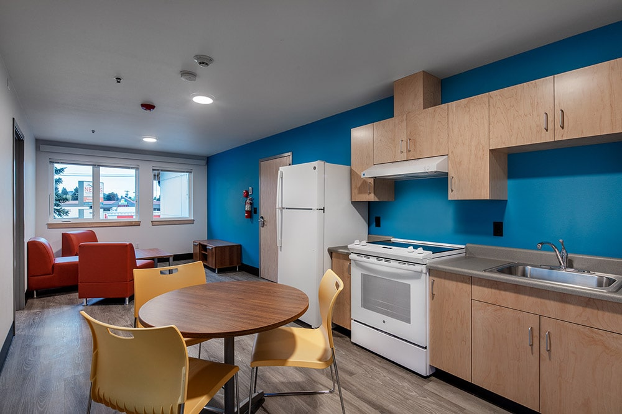
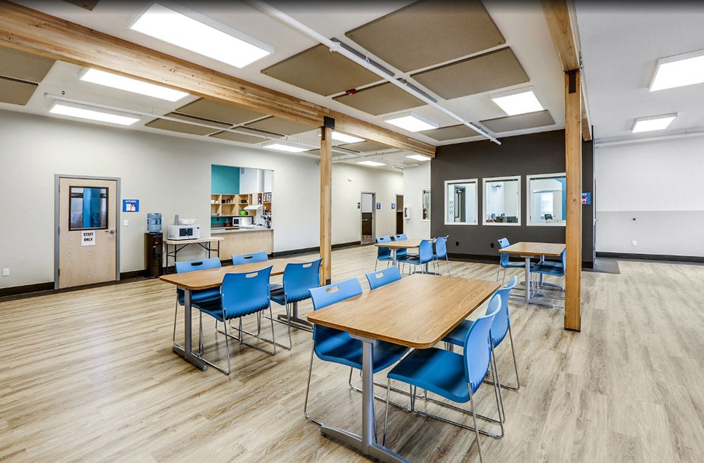
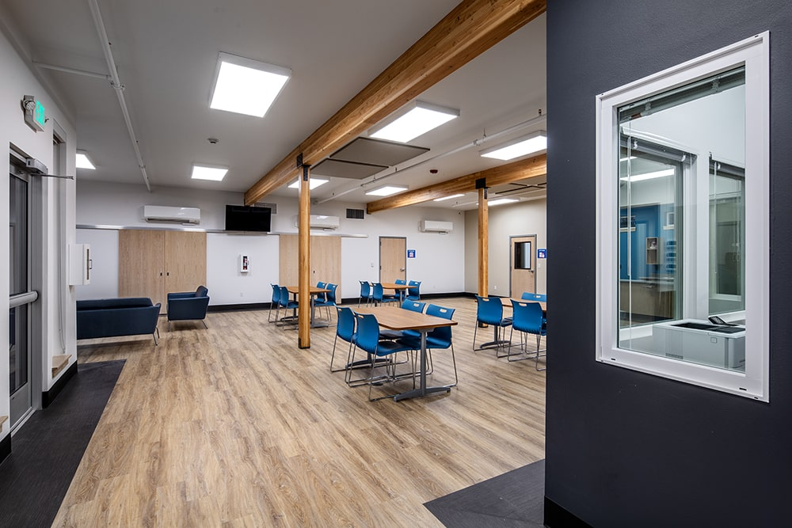
Completion: 2024 Square Footage: 7,894 SF
Construction Cost: $1.5 million Location: New York, New York Clients: Homeless youth aged 18-24 Contractor: SPS Construction
What We Do
Our project proposal centers on creating a transitional shelter specifically designed to address the issue of youth homelessness, recognizing it as an underreported and underserved crisis in our community. A substantial number of young individuals lack the necessary support and resources required to transition successfully into adulthood. This initiative will empower homeless youth aged 18-24 to cultivate the skills and resilience needed for independent, fulfilling lives. Our shelter project is inclusive and welcomes youth from diverse backgrounds, including LGBTQ+ youth, emancipated foster youth, and those with complex histories such as addiction or involvement in the juvenile justice system.

Slide 4
Resources
Human Resources
Financial
Resources
Physical
Resources
The project team is responsible for the successful execution of the project. Our team is composed of experienced professionals with the necessary skills and expertise to complete the project on time and within budget.
Our project budget is $1.5 million. This budget includes all expenses associated with the project, including salaries, construction, software/technology, and equipment. We have allocated these resources to ensure that we are able to complete the project within budget.
This project requires a number of external experts and specialized pieces of equipment. We will be using architects, electricians and IT experts. All equipment is in good working condition and has been tested and calibrated prior to install and use.

Slide 5
This timeline will provide a visual representation of our project's progress and ensure that the project stays on track. Our team will be regularly reviewing and updating the timeline as the project progresses to ensure that it remains accurate and achievable.

Slide 6


